Slide 1
Virtual Memory Module 6
Operating Systems
Nadia Qureshi

Slide 2
Virtual Memory
Why we need virtual memory
The program size may exceed the amount of physical memory
The OS keeps those parts of the program currently in use in main memory and the rest on disk
The piece of the program being swapped between disk and memory as needed even if the process size is bigger than main memory
This is called overlay where we roll-in and roll-out various pages in and out of memory to accommodate a bigger processes into memory
Virtual memory can also work in a multiprogramming system

Slide 3
Virtual Memory
A technique that allows execution of a process without having to allocate it the memory space it needs, completely
It gives the idea that large memory is available at programmer’s disposal even computer has relatively small main memory
A program can be written assuming large address space is available
That is the virtual address space >> physical address space
The entire logical address space of a process must be in physical memory before the process can execute
First Implemented in Intel 80386

Slide 4
Virtual Memory
Advantages of virtual memory:
Programs can be larger than the size of the physical memory
Virtual memory accommodates them
Virtual memory provides a logical view of memory which is larger than its physical size
Virtual memory is not easy to implement
May substantially decrease performance if it is used carelessly
Virtual memory can be implemented via:
Paging
Segmentation

Slide 5
Virtual Memory
Demand Paging
In demand paging, bring a page into main memory only when it is needed
Less I/O needed
Less memory needed
Faster response
More users
Page is needed ➔ reference to it
Invalid reference → abort
Not in memory → bring to memory
It can also be implemented in a segmentation system
Demand Segmentation
Demand segmentation can also be used to provide virtual memory
Several systems provide paged segmentation scheme
Segments are broken into pages
The IBM OS/2 uses demand segmentation

Slide 6
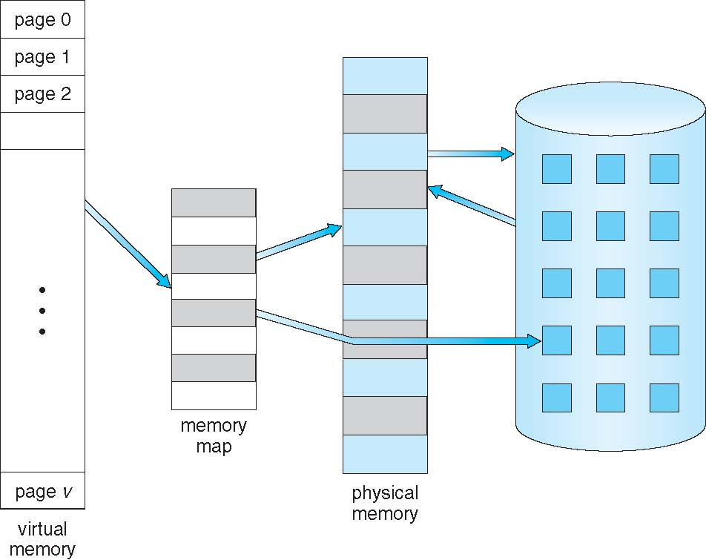
Virtual Memory
Virtual Memory is Larger Than Physical Memory

Slide 7
Mechanism of Virtual Memory
When a new process is initiated, the system loader must load one page (start point) into real memory
Execution of the process will commence
This will continue as long as memory references generated by this page also within the same page
If the virtual address generated will reference a page which is not in real memory; this is termed as page fault, which generates an interrupt
The demand paging will be used, and system loader will load the next demanded page
Execution will proceed after requested page is loaded
By a series of page faults occurring in this way, a sub-set (resident set) of the pages of a process will gradually accumulate in real memory
When the process terminates the OS releases all pages belonging to that process, making room for other processes

Slide 8
Mechanism of Virtual Memory
Additional techniques
Hardware techniques to improve performance of virtual paged system
Translation look aside buffer (TLB)
Associative mapping

Slide 9
Translation Look Aside Buffer
A bit is used in each page table entry to indicate whether the corresponding entry is in main memory or not
Each virtual memory reference can cause two physical memory accesses; one to fetch appropriate page table entry and one to fetch the desired data
To reduce this overhead on system performance a memory cache TLB is used in most of the systems
It is very fast and holds number of recently used page table entries
The virtual address translation process will first search in TLB. If found, the real address can be formed immediately. If not, normal accessing of page table will proceed
TLB holds limited number of page table entries

Slide 10
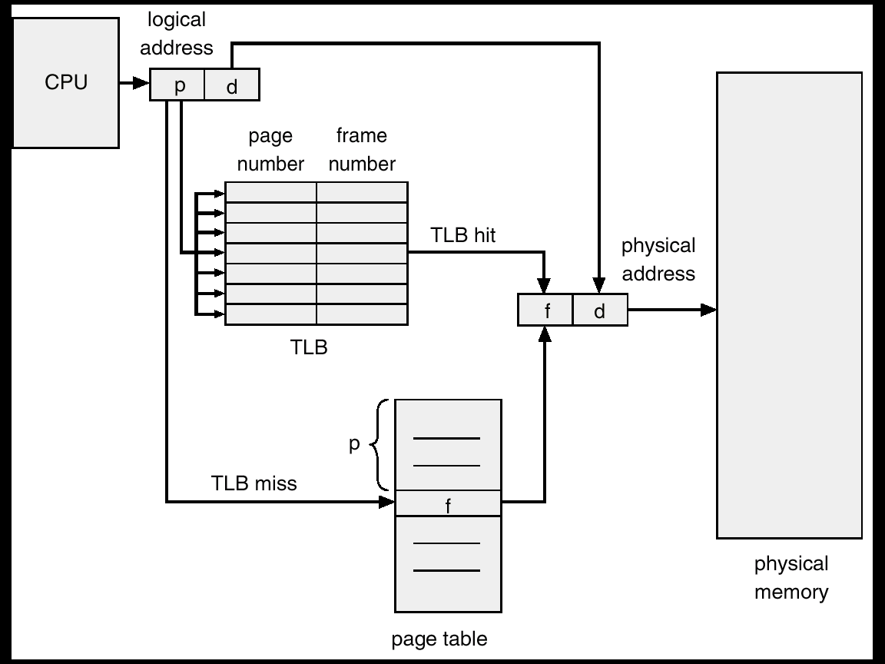
Translation Look Aside Buffer

Slide 11
Associative Mapping
An associative memory system (content addressable store) greatly increases the speed of searching for an item within an array of stored items
This hardware system compares a search value with every entry simultaneously within associative store
If TLB implemented as an associative memory then all entries can be interrogated for a virtual page number simultaneously, resulting in a very rapid response

Slide 12
Page Fault
If the virtual address created a reference for a page which is not in real memory; it is termed as page fault
Following measures should be done when a page fault occur
Get empty frame
Swap page into frame
Reset tables, present or valid bit = 1
Restart instruction

Slide 13
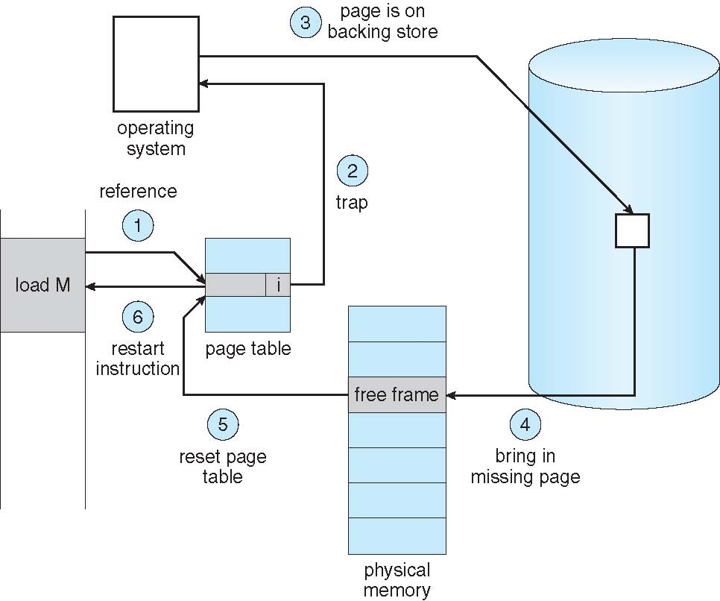
Page Fault Handling

Slide 14
Page Replacement Algorithms

Slide 15
Page Replacement
When a page fault occurs
The OS may have to remove a page from memory to make room for incoming page
If the page to be removed has been modified, it must be updated to disk
For better performance, at each page fault
Pick a random page from memory that is not heavily used and replace it
If a heavily used page is removed, it may have to brought back in quickly, resulting in extra overhead
Use modify (dirty) bit to reduce overhead of page transfers – only modified pages are written to disk

Slide 16
Page Replacement
Page replacement procedure
If no frame is free, we free a frame by writing its contents to disk
Change page table entry that the page is no longer in memory
Swap in new demanded page
Update the page table entry

Slide 17
Page Replacement Algorithms
There are different page replacement algorithms
Each OS has its own page replacement technique
The important thing is, it should be one with lowest page fault rate
Replacement policy/strategy is concerned with selecting a page currently in memory to be replaced
All policies are based on, the page that is removed should be the page least likely to be referenced in the near future
Principal of locality says, there is a high correlation between recent referencing history and near future referencing patterns
Most policies try to predict future behavior on the basis of past behavior

Slide 18
FIFO Algorithm
The FIFO maintain a list of all pages in memory with the page at the head the oldest one and page at the tail most recent arrival
On a page fault, the page at the head is removed and the new page added to tail of the list
Salient points
FIFO algorithm is very easy to implement
Its performance is not always good because it may replace pages heavily used throughout the life of a program
Low overhead paging algorithm

Slide 19
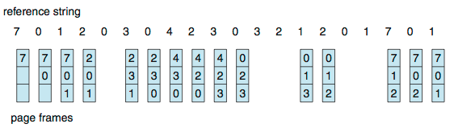
First-In-First-Out (FIFO) Algorithm
Reference string: 7,0,1,2,0,3,0,4,2,3,0,3,0,3,2,1,2,0,1,7,0,1
3 frames (3 pages can be in memory at a time per process)
Can vary by reference string: consider 1,2,3,4,1,2,5,1,2,3,4,5
Adding more frames can cause more page faults!
How to track ages of pages?
Just use a FIFO queue
15 page faults

